Slide 1


DataJoint - NWB Interoperability
Thinh Nguyen, Vathes LLC
8th User Days Workshop
May 14, 2020

Slide 2
Overview
Brief introduction of DataJoint
Modes of interoperability between DataJoint and NWB
Demo
Discussion

Slide 3
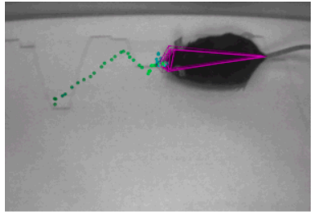
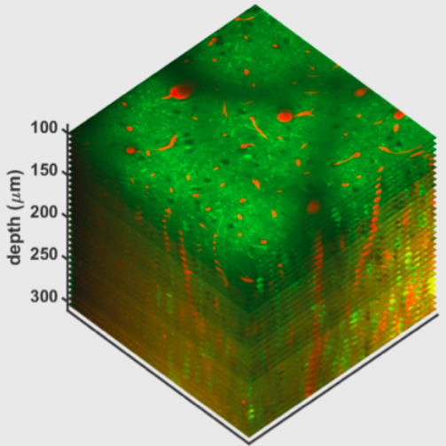
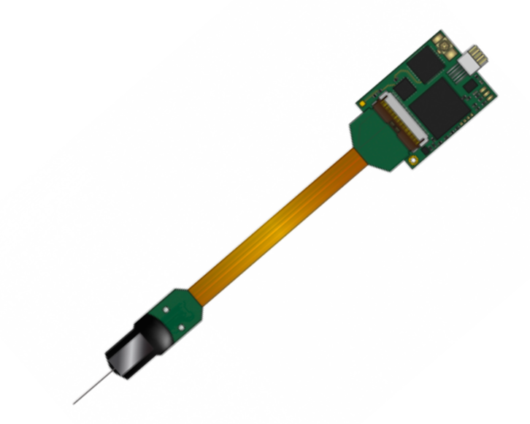
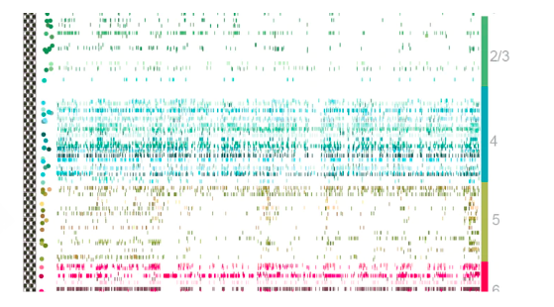
Neuroscience Data are getting bigger, richer, and more complex
behavior
imaging
electrophysiology

Slide 4




Workflow management framework
Data/Metadata
Dependencies
Distributed computation
Relational Database Systems
High-level programming languages
Good for complex data and metadata:
data integrity
support flexible queries
Not for sophisticated computations
Not very friendly to neuroscientists
Good for sophisticated computations
Friendly to neuroscientists
Not for complex data storage

Slide 5
demo (00)

Slide 6
try DataJoint at: https://playground.datajoint.io/

Slide 7
Options for interoperability
Export to NWB files from DataJoint pipeline
Store NWBFile in DataJoint table columns
Store NWB neurodata_type in DataJoint columns (e.g. Device, Electrode, PatchClampSeries)
Notes:
3 modes of interoperability between DataJoint and NWB, ordered by complexity

Slide 8
Options for interoperability
Export to NWB files from DataJoint pipeline
Store NWBFile in DataJoint table columns
Store NWB neurodata_type in DataJoint columns (e.g. Device, Electrode, PatchClampSeries)
Notes:
3 modes of interoperability between DataJoint and NWB, ordered by complexity

Slide 9
Case-study
Data of 11 publications (.mat or .nwb)
DataJoint pipeline
NWB
files
Standardized
https://github.com/vathes/DataJoint-NWB-showcase
Notes:
Most basic interoperability level
Design DJ pipeline to be more compatible with NWB standards
Export NWBFile per session from aggregated info/data from DJ pipeline
Project in collaboration with Svoboda’s lab at Janelia

Slide 10
Exporting to NWB file from DJ pipeline is not so much “integrated”
Custom export code
Can’t work interactively with the data as part of the pipeline
Does not benefit from DataJoint’s features:
Data integrity
Flexible Query

Slide 11
Options for interoperability
Export to NWB files from DataJoint pipeline
Store NWBFile in DataJoint table columns
Store NWB neurodata_type in DataJoint columns (e.g. Device, Electrode, PatchClampSeries)
Notes:
3 modes of interoperability between DataJoint and NWB, ordered by complexity

Slide 12
Regular data types of DataJoint tables
Data types supported by mySQL: internal
int, enum(“”, “”), varchar(), longblob...
DataJoint-specific data types: external
blob@external
attach@external
filepath@external
Notes:
Before we dive into how to store NWBFile in DataJoint, let’s have a quick recap on the type of data and storage solution supported by DataJoint

Slide 13
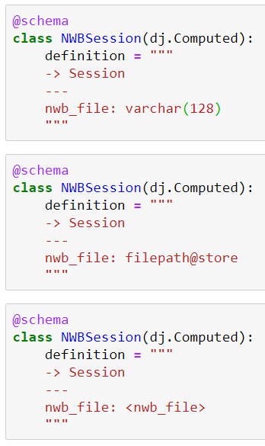
Regular data types of DataJoint tables
Data types supported by mySQL: internal
int, enum(“”, “”), varchar(), longblob...
DataJoint-specific data types: external
blob@external
attach@external
filepath@external
How to store and fetch NWB objects directly?

Slide 14
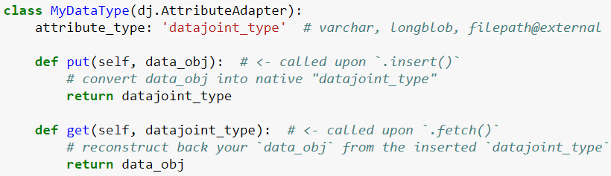
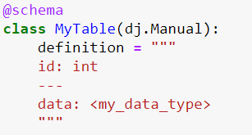
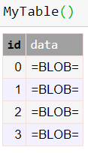
dj.AttributeAdapter (define arbitrary data types in DataJoint)
my_data_type
Insert into table
.put()
Fetch from table
.get()
Notes:
New feature developed in collaboration with Loren Frank lab
Allow users to go beyond native MySQL and DataJoint datatype, define any new arbitrary data type
Conceptually, this is how it works

Slide 15
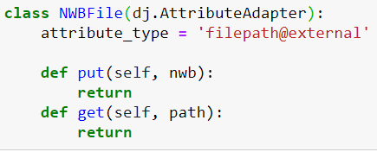
Store NWBFile as attribute
Subject
Per session, compute and store the corresponding NWBFile in a DJ table
One corresponding .nwb file per session behind the scene
Session
The rest of the pipeline
NWBSession
Notes:
An example design concept

Slide 16
Store NWBFile as attribute
demo (01)

Slide 17
Store NWBFile as attribute
Advantages Disadvantages
Easy to implement and manage
All metadata/data in one object/file
Queryable, fetchable
Working with NWB files outside of DataJoint
Static, not easily grow as new data are added
Potentially large physical file (with all aggregated metadata, data)

Slide 18
Options for interoperability
Export to NWB files from DataJoint pipeline
Store NWBFile in DataJoint table columns
Store NWB neurodata_type in DataJoint columns (e.g. Device, Electrode, PatchClampSeries)
Notes:
NWB neural datatype embedded throughout the entire pipeline, not just a single NWBFile at the end
Multiple .nwb files per session behind the scene, with external links, managed by DataJoint

Slide 19
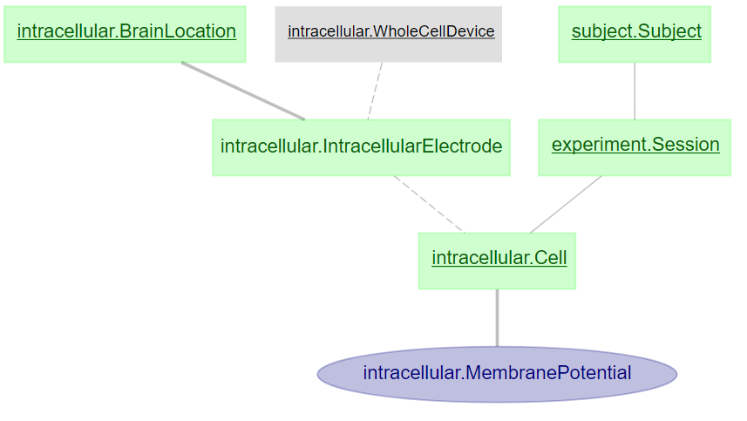
Store NWB neurodata_type as attribute
python dict
python dict
filepath@external (.nwb)
dj.AttributeAdapter for NWB neurodata_type
native DataJoint attribute type
filepath@external (.nwb)
Notes:
NWB neural datatype embedded throughout the entire pipeline, not just a single NWBFile at the end
Multiple .nwb files per session behind the scene, with external links, managed by DataJoint

Slide 20
Store NWB neurodata_type as attribute
demo (02)

Slide 21
Store NWB neurodata_type as attribute
subj0, ...
Advantages:
Flexible query/fetch on specific NWB object (e.g. filter by cell)
Dynamic, adaptable to new data
Deletion managed by DataJoint
Working with NWB files outside of DataJoint
Disadvantages:
More complex implementation
Multiple .nwb files and external links associated with one session
sess0, ...
cell0, cell1, cell2, ...
mp0, mp1, mp2, ...

Slide 22
Summary
DataJoint can be used to manage collection of files, with data integrity and flexible queries
NWB custom datatype can be closely integrated into DataJoint pipeline
Future Direction
Library of NWB neurodata_type adapters
Full DataJoint pipeline that is NWB-aware and has built-in function to export to “.nwb” file
U24 - Canonical data pipelines for neurophysiology

Slide 23


Thank you
Ben Dichter
Ryan Ly
Karel Svoboda
Loren Frank

Slide 24
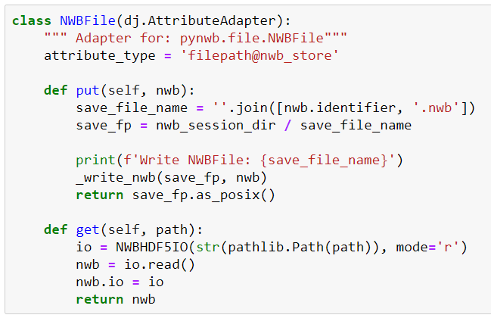
Advanced - Example AttributeAdapter object

Slide 25
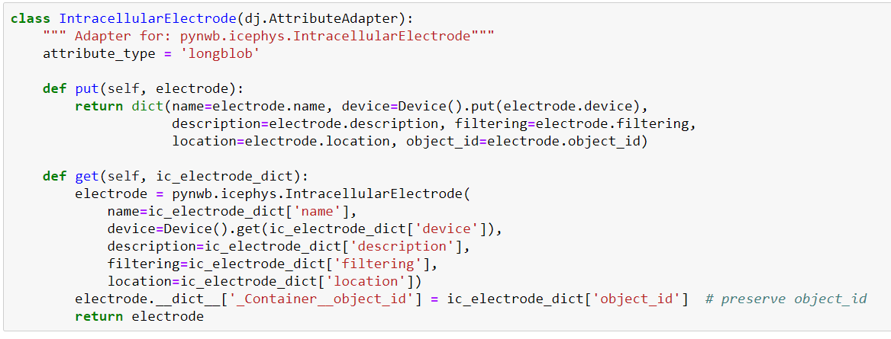
Advanced - Example AttributeAdapter object

